Slide 1
NETN FOM
NATO Education and Training Network (NETN) Federation Object Model (FOM)
NETN FOM is a modular IEEE 1516 (NATO STANAG 4603) High-Level Architecture (HLA) Federation Object Model (FOM)
NETN FOM is part of the Allied Modelling and Simulation Publication AMSP-04 (NATO STANREC 4800)
NETN FOM v3.0 is Modular

Slide 2
NETN-Aggregate
Aggregated Units
Ground Truth
Modeling Pattern
NETN-Physical
Physical Entities, Platforms & Lifeforms
Command and Control
Base Modules
NETN-SE
Facilities & Synthetic Environment Objects
NETN-COM
Communication Networks
NETN-METOC
Environment Conditions & Weather
NETN-CBRN
Chemical, Biological, Radiological & Nuclear
NETN-BASE
RPR-FOM Modules
NETN-LOG
Logistics Pattern
NETN-TMR
Transfer of Modelling Responsibilities Pattern
NETN FOM v3.0
Modules
NETN-MRM
Aggregation & Disaggregation Pattern
NETN-ETR
Entity Tasking & Reporting
NETN-ORG
Organizations & Relationships Initialization
NETN-AIS
Vessel Traffic Identification & Tracking
Notes:
* NETN-BASE
* NETN-Aggregate
* NETN-Physical
* NETN-CBRN
* NETN-METOC
* NETN-LOG
* NETN-TMR
* NETN-MRM
* NETN-AIS
* NETN-ETR
* NETN-ORG
* NETN-SE
* NETN-COM

Slide 3
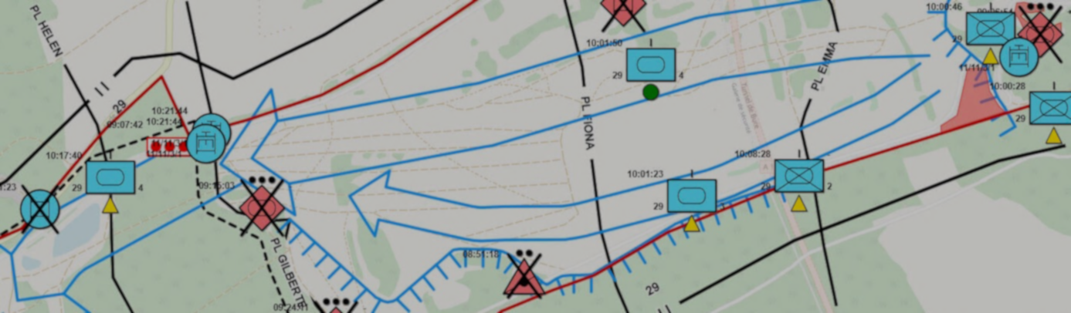
Aggregate Units
NETN-Aggregate
The NETN Aggregate and Physical FOM modules are extensions to the corresponding RPR-FOM v2.0 FOM modules for representing Ground Truth state of Aggregate Entities, Platforms, Equipment, Life Forms, Cultural Features and Environment Objects.
UUID attribute based on MSDL/NETN-ORG are used to uniquely identify simulated entities in a scenario.

Slide 4

Physical Entities, Platforms & Lifeforms
NETN-Physical
The NETN Aggregate and Physical FOM modules are extensions to the corresponding RPR-FOM v2.0 FOM modules for representing Ground Truth state of Aggregate Entities, Platforms, Equipment, Life Forms, Cultural Features and Environment Objects.
UUID attribute based on MSDL/NETN-ORG are used to uniquely identify simulated entities in a scenario.

Slide 5

Facilities and Sythetic Environment
NETN-SE

Slide 6

Communication Networks
NETN-COM

Slide 7

Environment Conditions & Weather
NETN-METOC
Representation of environment conditions associated with geographical locations, areas, simulated entities, and terrain features.
Terrain Surface
Water Surface
Atmospheric Layers
Subsurface volumes of water

Slide 8

Chemical, Biological, Radiological and Nuclear M&S
NETN-CBRN
The NETN Chemical, Biological, Radiological and Nuclear (CBRN) module defines a standard way to distribute dispersion calculations and information about dispersion effects on entities and the environment.
Source release & Hazard area
CBRN Detectors
CBRN Effects
Protective measures

Slide 9

Organizational Relationships and Initialization
NETN-ORG
The NETN-ORG FOM module provides a standard way of representing the state, organization and relationships of units at a given point in time. Used for (re-)initialization of scenarios and for distributing dynamic changes of organizational relationships.
Dynamic Task Organisation
Force Relationships
Based on SISO-STD-007-2008: Military Scenario Definition Language (MSDL) with extensions.

Slide 10

Logistics Pattern
NETN-LOG
The NETN Logistics (LOG) module defines patterns used by federated systems to negotiate and collectively simulate logistics operations involving resource transfer, repairs and transport.
Refuelling of aircraft at an airbase or in the air
Transport of supplies between facilities
Repair of damaged platforms in a facility or by unit
Transport of units, platforms, and humans by train, ship, or aircraft

Slide 11

Transfer of Modelling Responsibilities
NETN-TMR
The NETN Transfer of Modelling Responsibility (TMR) module is used to dynamically change which system is responsible for the simulation of a specific object in the synthetic environment.
Transfer from a Live to a Virtual or Constructive simulation
Transfer between Virtual and Constructive simulations
Transfer between hi- and low-fidelity models
Transfer to allow backup, maintenance or load-balancing
Transfer of certain attributes to functional models such as movement, damage assessment etc.

Slide 12

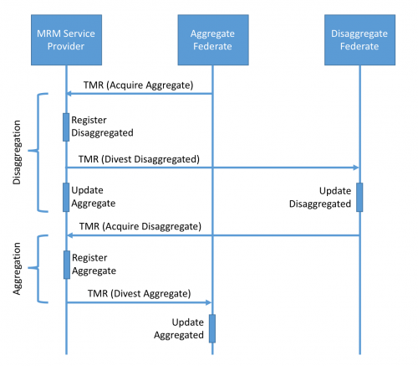
Aggregation & Disaggregation
NETN-MRM
The NETN Multi-Resolution Modelling (MRM) module provides a standard way to manage aggregation and disaggregation of simulated units and physical entities.

Slide 13

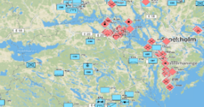
Entity Tasking & Reporting
NETN-ETR
The NETN Entity Tasking & Reporting (ETR) module represent lower-level tasks suitable for providing simulation instructions to federates modelling individual units or platforms.
ETR
Sim
Sim
Sim
RTI

Slide 14

Vessel Identification and Data
NETN-AIS
Simulation oriented representation of vessel traffic identification and data used by the international Automatic Identification System (AIS)
Navigation Data including posistion, speed, direction etc.
Voyage Data including destination, route, cargo etc.

Slide 15
NETN FOM
Not Classified – Free to use – Free to distribute
NETN FOM Modules are ”NOT CLASSIFIED”.
NETN FOM Copyright (C) NATO/OTAN
NETN FOM Modules are licensed under a Creative Commons Attribution-NoDerivatives 4.0 International License.
Free to use, Free to distribute with attribution
All NETN Modules are available on GitHub
https://github.com/AMSP-04

Slide 16
NETN FOM
Maintained
All updates and versioning of this work is
coordinated by the NATO Modelling and Simulation Coordination Office (MSCO),
managed by the NATO Modelling and Simulation Group (NMSG) and
performed as NATO Science and Technology Organization (STO) technical activities
in support of the NMSG Modelling and Simulation Standards Subgroup (MS3).

